Slide 1
Guide to Networking Essentials,
6th Edition
Chapter 10: Introduction to Network Security

Slide 2
Objectives
Develop a network security policy
Secure physical access to network equipment
Secure network data
Use tools to find network security weaknesses
Copyright © 2012 Cengage Learning. All rights reserved.

Slide 3
Network Security Overview and Policies
Network security should be as unobtrusive as possible
  Allowing network users to concentrate on the tasks they want to accomplish rather than how to get to the data they need to perform those tasks
Having a secure network enables an organization to go about its business confidently and efficiently
A company that can demonstrate its information systems are secure is more likely to attract customers, partners, and investors
Copyright © 2012 Cengage Learning. All rights reserved.

Slide 4
Developing a Network Security Policy
A network security policy is a document that describes the rules governing access to a company’s information resources, enforcement of these rules, and steps taken if rules are breached
A security policy should:
  Be easy for ordinary users to understand and reasonably comply with
  Be enforceable. Example: You shouldn’t forbid Internet use during a certain time of day unless you have a method of monitoring or restricting this use
  Clearly state the objective of each policy so that everyone understands its purpose
Copyright © 2012 Cengage Learning. All rights reserved.

Slide 5
Determining Elements of a Network Security Policy
Basic items needed in order to start writing your security policy:
  Privacy policy: Describes what staff, customers, and business partners can expect for monitoring and reporting
  Acceptable use policy: Explains for what purposes network resources can be used
  Authentication policy: Describes how users identify themselves to gain access to network resources
  Internet use policy: Explains what constitutes proper or improper use of Internet resources
Copyright © 2012 Cengage Learning. All rights reserved.

Slide 6
Determining Elements of a Network Security Policy
Basic items needed in order to start writing your security policy (continued):
  Access policy: Specifies how and when users are allowed to access network resources
  Auditing policy: Explains the manner in which security compliance or violations can be verified and the consequences for violations
  Data protection: Outlines the policies for backup procedures, virus protection, and disaster recovery
Copyright © 2012 Cengage Learning. All rights reserved.

Slide 7
Understanding Levels of Security
Before determining the level of security your network needs, answer these questions:
  What must be protected?
  From whom should data be protected?
  What costs are associated with security being breached and data being lost or stolen?
  How likely is it that a threat will actually occur?
  Are the costs to implement security and train personnel to use a secure network outweighed by the need to create an efficient, user-friendly environment?
Depending on your answers, you’ll likely implement one of the levels of security on the following slides
Copyright © 2012 Cengage Learning. All rights reserved.

Slide 8
Understanding Levels of Security
Highly Restrictive Security Policies
  Include features such as data encryption, complex password requirements, detailed auditing and monitoring of computer and network access, intricate authentication methods, and policies governing use of the Internet and e-mail
  Expensive to implement and support
Moderately Restrictive Security Policies
  Require passwords for each user but not overly complex
  Auditing is geared toward detecting unauthorized logon attempts, misuse of network resources, and network attacker activity
  Can use moderately priced off-the-shelf hardware and software, such as firewalls and access control lists
Copyright © 2012 Cengage Learning. All rights reserved.

Slide 9
Understanding Levels of Security
Open Security Policies
  Consist of simple or no passwords, unrestricted access to resources, and probably no monitoring and auditing
  Might make sense for a small company with the main goal of making access to network resources easy
  Sensitive data might be kept on workstations that are backed up regularly and physically inaccessible to other employees
No matter which type of policy a company uses, some common elements should be present:
  Virus and other malware protection for servers and desktops
  Backup procedures
  Physical security of servers and network devices
Copyright © 2012 Cengage Learning. All rights reserved.

Slide 10
Securing Physical Access to the Network
Best practices to secure your network from physical assault:
  Ensure that rooms are available to house servers and equipment. These rooms should have locks, adequate power receptacles, adequate cooling measures, and an EMI-free environment
  If a suitable room is not available, locking cabinets can be purchased to house servers and equipment in public areas
  Wiring from workstations to wiring cabinets should be inaccessible to eavesdropping equipment
  Your physical security plan should include procedures for recovery from natural disasters such as fire or floods
Copyright © 2012 Cengage Learning. All rights reserved.

Slide 11
Physical Security of Servers
Servers can generate a substantial amount of heat and need adequate cooling
  Lack of cooling can damage hard drives, cause CPUs to shut down or malfunction, and damage power supplies
Power to the server should be on a separate circuit from other electrical devices
  Enough power outlets should be installed to eliminate the need for extension cords
  Verify power requirements for UPSs. Some UPSs require special twist-lock outlet plugs rated for high currents
If you’re forced to place servers in a public access area, locking cabinets are a must
Copyright © 2012 Cengage Learning. All rights reserved.

Slide 12
Security of Internetworking Devices
Routers and switches contain critical configuration information
  A user with physical access to these devices needs only a laptop or handheld computer to get into the router or switch
Configuration changes made to routers and switches can have disastrous results
A room with a lock is the best place for internetworking devices
  A wall-mounted enclosure with a lock is the next best thing
  Some cabinets have a built-in fan or a mounting hole for a fan
  Most racks also come with channels to run wiring
Copyright © 2012 Cengage Learning. All rights reserved.

Slide 13
Securing Access to Data
Securing data on a network:
  Authentication and authorization
  Encryption
  Virtual private networks (VPNs)
  Firewalls
  Virus and worm protection
  Spyware protection
  Wireless security
Copyright © 2012 Cengage Learning. All rights reserved.

Slide 14
Implementing Secure Authentication and Authorization
Allow administrators to control who has access to the network (authentication) and what users can do after they are logged on to the network (authorization)
Network OSs include tools that enable administrators to specify options and restrictions on how and when users can log on to the network
File system access controls and user permission settings determine what a user can access on a network
  Also controls what actions a user can perform on the network, such as installing software or shutting down a system
Copyright © 2012 Cengage Learning. All rights reserved.

Slide 15
Configuring Password Requirements in a Windows Environment
Windows 7 allows passwords up to 128 characters
  Minimum of five to eight characters is typical
Other password options include:
  Maximum password age
  Minimum password age
  Enforce password history: Determines how many different passwords must be used before a password can be used again
Password policies for Windows 7 or Windows Server 2008 can be set in the Local Security Policy console found in Administrative Tools
Copyright © 2012 Cengage Learning. All rights reserved.

Slide 16
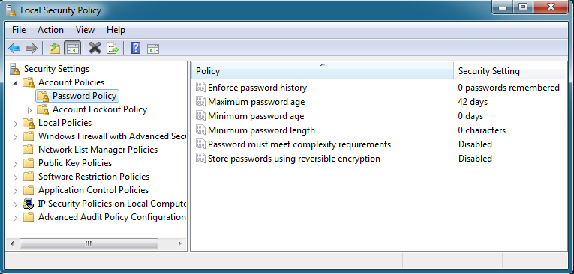
Configuring Password Requirements in a Windows Environment
Password policy settings in Windows 7
Copyright © 2012 Cengage Learning. All rights reserved.

Slide 17
Configuring Password Requirements in a Linux Environment
Linux password configuration can be done globally or on a user-by-user basis
Like Windows, Linux has a number of password options that can be configured
  For these password options to be available, the Linux system must be using shadow passwords, a secure method of storing user passwords on a Linux system
Password options can be set by editing the /etc/login.defs configuration file
Other password options can be configured by using Pluggable Authentication Modules (PAM)
Copyright © 2012 Cengage Learning. All rights reserved.

Slide 18
Reviewing Password Dos and Don’ts
Do use a combination of uppercase letters, lowercase letters, and numbers
Do include one or more special characters
Do consider using a phrase, such as NetW@ork1ng!sC001
Don’t use passwords based on your logon name, your family members’ or pets’ names
Don’t use common dictionary words unless they are part of a phrase
Don’t make your password so complex that you forget it
Copyright © 2012 Cengage Learning. All rights reserved.

Slide 19
Restricting Logon Hours and Logon Location
Both Windows and Linux have solutions to restrict logon by time of day, day of week, and location
In Windows, the default settings allow logon 24 hours a day, seven days a week
A common use of restricting logon hours is to disallow logon during a system backup
Users can be restricted to logging on only from particular workstations
  If a user who has access to sensitive data logs on at a workstation in a coworker’s office and then walks away, the coworker now has access to sensitive data
Copyright © 2012 Cengage Learning. All rights reserved.

Slide 20
Authorizing Access to Files and Folders
Windows OSs have two options for file security: sharing permissions and NTFS permissions
Sharing permissions are applied to folders (files in a shared folder inherit the same permission)
NTFS permissions can be applied to files as well as folders
File and folder permissions are a necessary tool administrators use to make network resources secure
Copyright © 2012 Cengage Learning. All rights reserved.

Slide 21
Securing Data with Encryption
Encryption prevents people from using eavesdropping technology—such as a packet sniffer—to capture packets
The most widely used method for encrypting data is using IP Security (IPSec)
Preshared key - series of letters, numbers, and special characters that two devices use to authenticate each other’s identity (administrator enters the same key in the IPSec settings on both devices)
Kerberos authentication - also uses keys, but the OS generates the keys
Copyright © 2012 Cengage Learning. All rights reserved.

Slide 22
Securing Data with Encryption
Digital certificates - involves a certification authority (CA)
  Someone wanting to send encrypted data must apply for a digital certificate from a CA, which is responsible for verifying the applicant’s authenticity
  Public CAs, such as Verisign, sell certificates to companies wanting to have secure communication sessions across public networks
On Linux systems, a simple method for encrypting files is using gpg (Gnu Privacy Guard), a command-line program
  This program uses a password the user enters to encrypt the file specified as an argument to the gpg command
Copyright © 2012 Cengage Learning. All rights reserved.

Slide 23
Securing Data on Disk Drives
If someone gains access to the hard disk where data is stored, your data could be vulnerable
In Windows OSs, Encrypting File System (EFS) is used to encrypt files or folders
EFS works in one of three modes:
  Transparent mode: Requires hardware with trusted platform module (TPM) support and protects the system if someone tries to boot with a different OS
  USB key mode: An encryption key is stored on a USB drive that the user inserts before starting the system
  User authentication mode: The system requires a user password before it decrypts the OS files and boots
Copyright © 2012 Cengage Learning. All rights reserved.

Slide 24
Securing Communication with Virtual Private Networks
A virtual private network (VPN) is a network connection that uses the Internet to give users or branch offices secure access to a company’s network resources
VPNs use encryption technology to ensure the communication is secure while traveling through the public Internet
  A “tunnel” is created between the VPN client and VPN server
VPN servers can be configured on server OSs or they can be in the form of a dedicated device with the sole purpose of handling VPN connections
Copyright © 2012 Cengage Learning. All rights reserved.

Slide 25
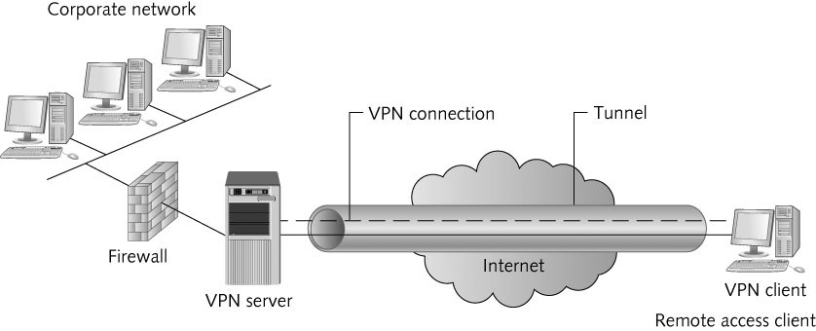
Securing Communication with Virtual Private Networks
A typical VPN connection
Copyright © 2012 Cengage Learning. All rights reserved.

Slide 26
VPNs in a Windows Environment
Windows server OSs include a VPN server solution with Routing and Remote Access (RRAS)
Windows 2008 supports three implementations of VPN:
  Point-to-Point Tunneling Protocol (PPTP): A commonly used VPN protocol in Windows OSs with client support for Linux and Mac OS X
  Layer 2 Tunneling Protocol with IPSec (L2TP/IPSec): Provides a higher level of security than PPTP. Provides data integrity as well as identity verification
  Secure Socket Tunneling Protocol (SSTP): Works behind most firewalls without firewall administrators needing to configure the firewall to allow VPN
All three implementations are enabled by default when you configure Windows Server 2008 as a VPN server
Copyright © 2012 Cengage Learning. All rights reserved.

Slide 27
VPNs in Other OS Environments
Linux OSs also support VPN client and VPN server applications (typically use PPTP or L2TP/IPSec)
  A popular VPN solution for Linux is a free package called OpenSwan)
Mac OS X supports VPN client connections to Windows servers by using PPTP or IPSec
Mac OS X Server has a VPN server service that allows Mac OS X, Windows, and UNIX/Linux clients to connect to a corporate LAN through the Mac OS X VPN server
Copyright © 2012 Cengage Learning. All rights reserved.

Slide 28
VPN Benefits
VPN benefits include the following:
  Enable mobile users to connect with corporate networks securely wherever an Internet connection is available
  Allow multiple sites to maintain permanent secure connections via the Internet instead of using expensive WAN links
  Can reduce costs by using the ISP’s support services instead of paying for more expensive WAN support
  Eliminate the need to support dial-up remote access
Copyright © 2012 Cengage Learning. All rights reserved.

Slide 29
Protecting Networks with Firewalls
A firewall is a hardware device or software program that inspects packets going into or out of a network or computer, then discards or forwards these packets based on a set of rules
A hardware firewall is configured with two or more network interfaces, typically placed between a corporate LAN and the WAN connection
A software firewall is installed in an OS and inspects all packets coming into or leaving the computer
  Based on predefined rules, the packets are discarded or forwarded for further processing
Copyright © 2012 Cengage Learning. All rights reserved.

Slide 30
Protecting Networks with Firewalls
Firewalls protect against outside attempts to access resources and protect against malicious packets intended to disable a network and its resources
  Firewalls can also be used to restrict users’ access to Internet resources
After installed, the administrator must build rules that allow only certain packets to enter or exit the network
  Can be based on source and destination addresses, protocols such as IP, TCP, ICMP, and HTTP
Firewalls can also attempt to determine a packet’s context (process called stateful packet inspection)
  SPI helps ensure that a packet is denied if it’s not part of an ongoing legitimate conversation
Copyright © 2012 Cengage Learning. All rights reserved.

Slide 31
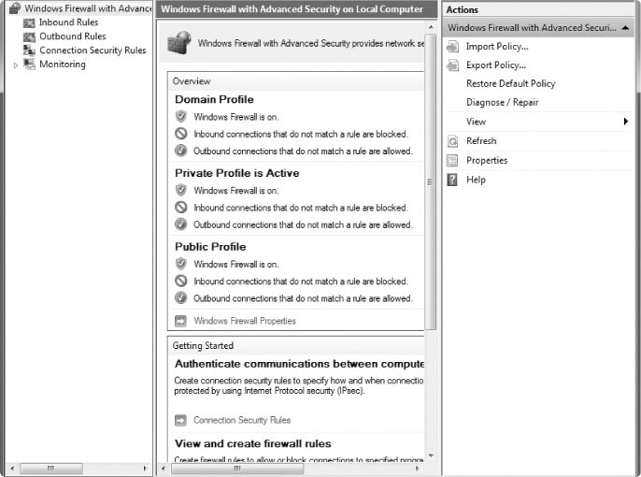
Protecting Networks with Firewalls
Copyright © 2012 Cengage Learning. All rights reserved.

Slide 32
Protecting Networks with Firewalls
Routers can be used as firewalls
Network administrators can create rules, called access control lists (ACLs), that deny certain types of packets
  ACLs can examine many of the same packet properties that firewalls can
An intrusion detection system (IDS) usually works with a firewall or router
  Detects an attempted security breach and notifies the administrator
  In some cases an IDS can take countermeasures like resetting the connection between source and destination devices
Copyright © 2012 Cengage Learning. All rights reserved.

Slide 33
Protecting Networks with Firewalls
Because most networks use Network Address Translation (NAT) with private IP addresses, devices configured with private IP addresses can’t be accessed directly from outside the network
When NAT is used, an external device can’t initiate a network conversation with an internal device
Copyright © 2012 Cengage Learning. All rights reserved.

Slide 34
Protecting a Network from Worms, Viruses, and Rootkits
A virus is a program that spreads by replicating itself into other programs or documents
  Purpose is to disrupt computer or network operation by deleting or corrupting files, formatting disks, or using large amounts of computer resources
A worm is similar to a virus but a worm doesn’t attach itself to another program
  Can create a backdoor, which is a program installed on a computer that permits access to the computer, bypassing normal authentication process
Rootkits are a form of a Trojan program that can monitor traffic to and from a computer (capturing passwords and other important information)
Copyright © 2012 Cengage Learning. All rights reserved.

Slide 35
Protecting a Network from Worms, Viruses, and Rootkits
Viruses, worm, and rootkits are part of a broader category of software called malware, which is any software designed to cause harm or disruption
Every desktop and server should have virus-scanning software running
  Most virus-protection software is also designed to detect and prevent worms
Virus and worm protection can be expensive but perhaps worth it if loss of data and productivity can be avoided
  Virus software must be updated because developers of viruses and worm software are always looking for new ways to wreak havoc
Copyright © 2012 Cengage Learning. All rights reserved.

Slide 36
Protecting a Network from Spyware and Spam
Spyware is a type of malware that monitors or controls part of your computer at the expense of your privacy
  Spyware usually decreases your computer’s performance and increases pop-up Internet messages and spam
Many antispyware programs are available – some are bundled with antivirus programs
Spam is more of a nuisance than a threat to your computer
  Unsolicited e-mail that takes up e-mail storage space, network bandwidth and people’s time
Copyright © 2012 Cengage Learning. All rights reserved.

Slide 37
Implementing Wireless Security
An attacker does not need physical access to your network cabling to compromise the network
  Anyone with a wireless scanner and some software can intercept data or access wireless devices
Wireless security must be enabled on all your devices by using one or more of the following methods:
  Service set identifier (SSID) – An SSID is an alphanumeric label configured on the access point – each client must configure its wireless NIC for that SSID to connect to that access point
Copyright © 2012 Cengage Learning. All rights reserved.

Slide 38
Implementing Wireless Security
Wireless security options (continued):
  MAC address filtering: If network is small, you can use the MAC address filtering feature on APs to restrict network access to computers with specific MAC addresses
  Wired Equivalency Protocol (WEP): Provides data encryption so that a casual attacker who gains access sees only encrypted data
  Wi-Fi Protected Access (WPA): Similar to WEP, only has enhancements that make cracking the encryption code more difficult
  802.11i : Usually referred to as WPA2 because it incorporates much of the WPA standard – advantage over WPA is that it uses more advanced encryption standards and a more secure method of handing encryption keys
Copyright © 2012 Cengage Learning. All rights reserved.

Slide 39
Using an Attacker’s Tools to Stop Network Attacks
The terms black hats and white hats are sometimes used to describe an individual skilled at breaking into a network
  Black hats are the bad guys, white hats are the good guys
White hats use the term penetration tester for their consulting services
  A certification has been developed for white hats called Certified Ethical Hacker (CEH)
  White hats try to hack into a network to see what types of holes exist in a network’s security and close them
Copyright © 2012 Cengage Learning. All rights reserved.

Slide 40
Discovering Network Resources
Attackers use command-line utilities to discover as much about your network as they can
  Ping, Traceroute Finger, and Nslookup are some utilities used
A ping scanner is an automated method for pinging a range of IP addresses
A port scanner determines which TCP and UDP ports are available on a particular computer or device
  By determining which ports are active, a port scanner can tell you what services are enabled on a computer
Copyright © 2012 Cengage Learning. All rights reserved.

Slide 41
Discovering Network Resources
Protocol analyzers allow you to capture packets and determine which protocol services are running
  Require access to the network media
The use of the Finger utility can be disabled by turning it off on all UNIX, Linux servers and routers
  A port scan should be run on all network devices to see what services are on, and then services that aren’t necessary should be turned off
To protect against the use of protocol analyzers, all hubs and switches should be secured in a locked room or cabinet
Copyright © 2012 Cengage Learning. All rights reserved.

Slide 42
Gaining Access to Network Resources
After an attacker has discovered the resources available, the next step might be gaining access
  Will try to gain access via devices that have no password set
Finger can be used to discover usernames
Linux and Windows servers have default administrator names that are often left unchanged
  An attacker with a password-cracking tool can easily exploit
Using a password-cracking tool on your own system is recommended to see whether your passwords are complex enough
Copyright © 2012 Cengage Learning. All rights reserved.

Slide 43
Disabling Network Resources
A denial-of-service (DoS) attack is an attacker’s attempt to tie up network bandwidth or network services
  Three common types of DoS attacks focus on typing up a server or network service
    Packet storms: use the UDP protocol to send UDP packets that have a spoofed (made up) host address, causing the host to be unavailable to respond to other packets
    Half-open SYN attacks: use the TCP three-way handshake to tie up a server with invalid TCP sessions
    A ping flood sends a large number of ping packets to a host – they cause the host to reply, typing up CPU cycles and bandwidth
Copyright © 2012 Cengage Learning. All rights reserved.

Slide 44
Chapter Summary
A network security policy is a document that describes the rules governing access to a company’s information resources
A security policy should contain these types of policies: privacy policy, acceptable use policy, authentication policy, Internet use policy, auditing policy, and data protection policy
Securing physical access to network resources is paramount
Securing access to data includes authentication and authorization, encryption/decryption, VPNs, firewalls, virus and worm protection, spyware protection and wireless security
Copyright © 2012 Cengage Learning. All rights reserved.

Slide 45
Chapter Summary
VPNs are an important aspect of network security because they provide secure remote access to a private network via the Internet
Firewalls, a key component of any network security plan, filter packets and permit or deny packets based on a set of defined rules
Malware encompasses viruses, worms, Trojan programs, and rootkits
Wireless security involves attention to configuring a wireless network’s SSID correctly and configuring and using one of several wireless security protocols, such as WEP, WPA, or 802.11i
Copyright © 2012 Cengage Learning. All rights reserved.

Slide 46
Chapter Summary
Tools that attackers use to compromise a network can also be used to determine whether a network is secure.
Denial of service is one method attackers use to disrupt network operation. Three types of DoS attacks include half-open SYN attacks, ping floods, and packet storms.
Copyright © 2012 Cengage Learning. All rights reserved.

